Slide 1
Decision Trees and Random Forests
Materials: ://bit.ly/2ot4qhttpsp7
Check in: http://bit.ly/2mfZkf2
302316

Slide 2
1) Decision Trees
What are they and where can they be applied?
2) Ensemble Learning
General Concepts and Random Forests
3) Case Study
Applying what we learnt to a real world dataset!

Slide 3
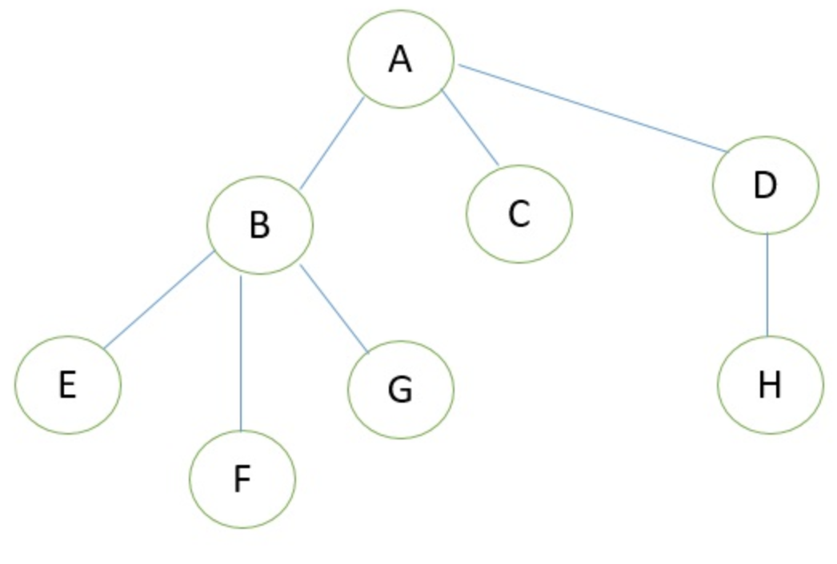
So, what are these trees you speak of?
An abstraction of data
Mostly represent hierarchical relationships.
Applications in multiple fields!

Slide 4
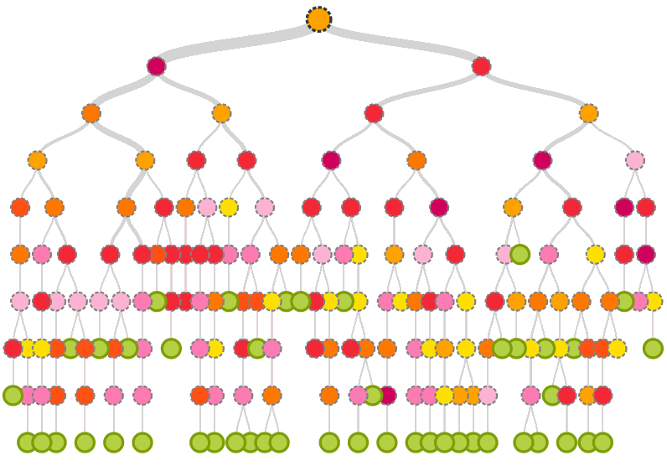
Enter Decision Trees
Simple, but extremely versatile supervised learning algorithm.
Able to perform classification and regression!
Building blocks for many powerful models.

Slide 5
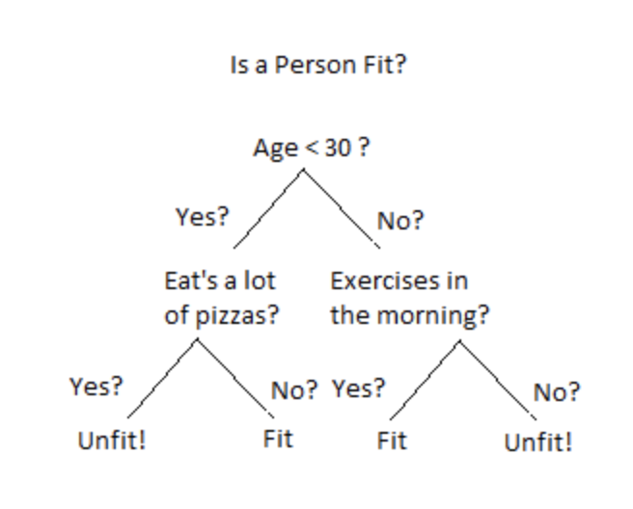
Jumping into the algorithm: Splitting
Dataset is broken down into smaller and smaller subsets via splitting!
Each split represents a binary decision being made on a specific attribute of the data.

Slide 6
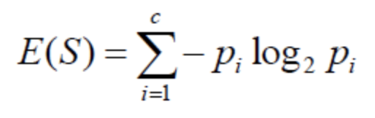
Jumping into the algorithm: What makes a good split?
Need to divide the data into subsets of similar values.
Entropy: Measure of disorder amongst a sample.
Information Gain: Decrease in entropy after dataset is split on an attribute.
Goal is to perform a split that returns the highest information gain.

Slide 7
Actually jumping into the algorithm….
Calculate entropy of target.
Calculate entropy for each branch.
Choose attribute with largest information gain.
Repeat

Slide 8
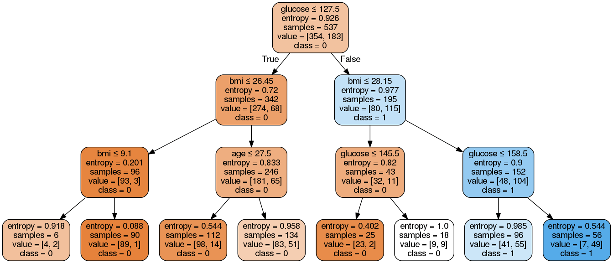
An example

Slide 9
Preventing Overfitting: Pruning
Algorithm is extremely prone to overfitting.
Reducing the size of the tree by converting decision nodes into leaf nodes.
Results in models that generalize well.

Slide 10
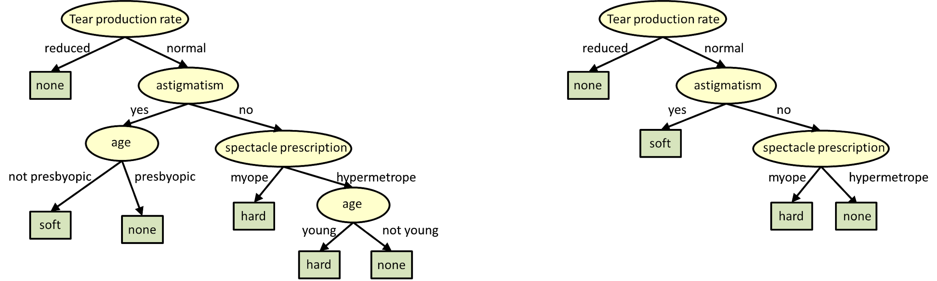
An Example of Pruning

Slide 11
Ensemble Learning: is one tree the best we can do?
Model that makes predictions based on a number of different models.
Bragging: Training a bunch of models in a parallel way. Each model uses random subset of data!

Slide 12
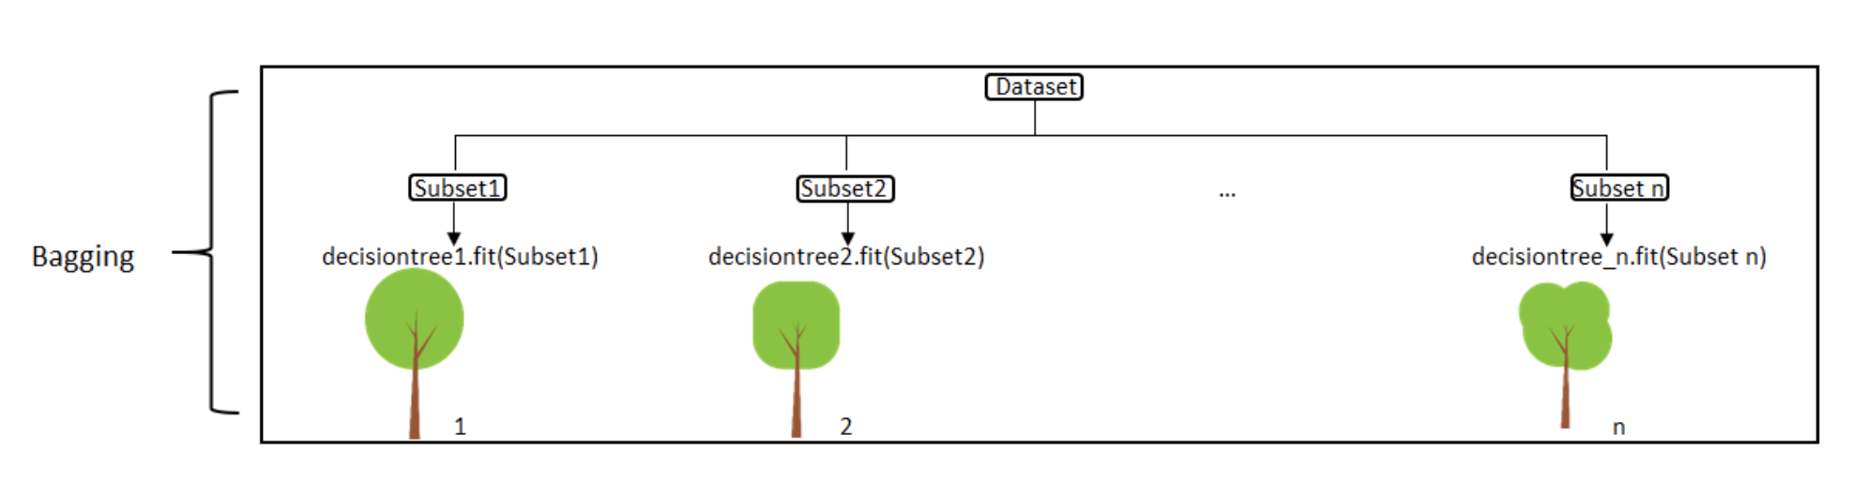
Bagging Visualized

Slide 13
Let’s grow some trees: Random Forests
Ensemble method that uses bragging as the ensemble method and decision tree as the individual model.
Select n random subsets of the data.
Train n decision trees.
Obtain prediction from each tree.
Make final prediction based on the majority vote!

Slide 14
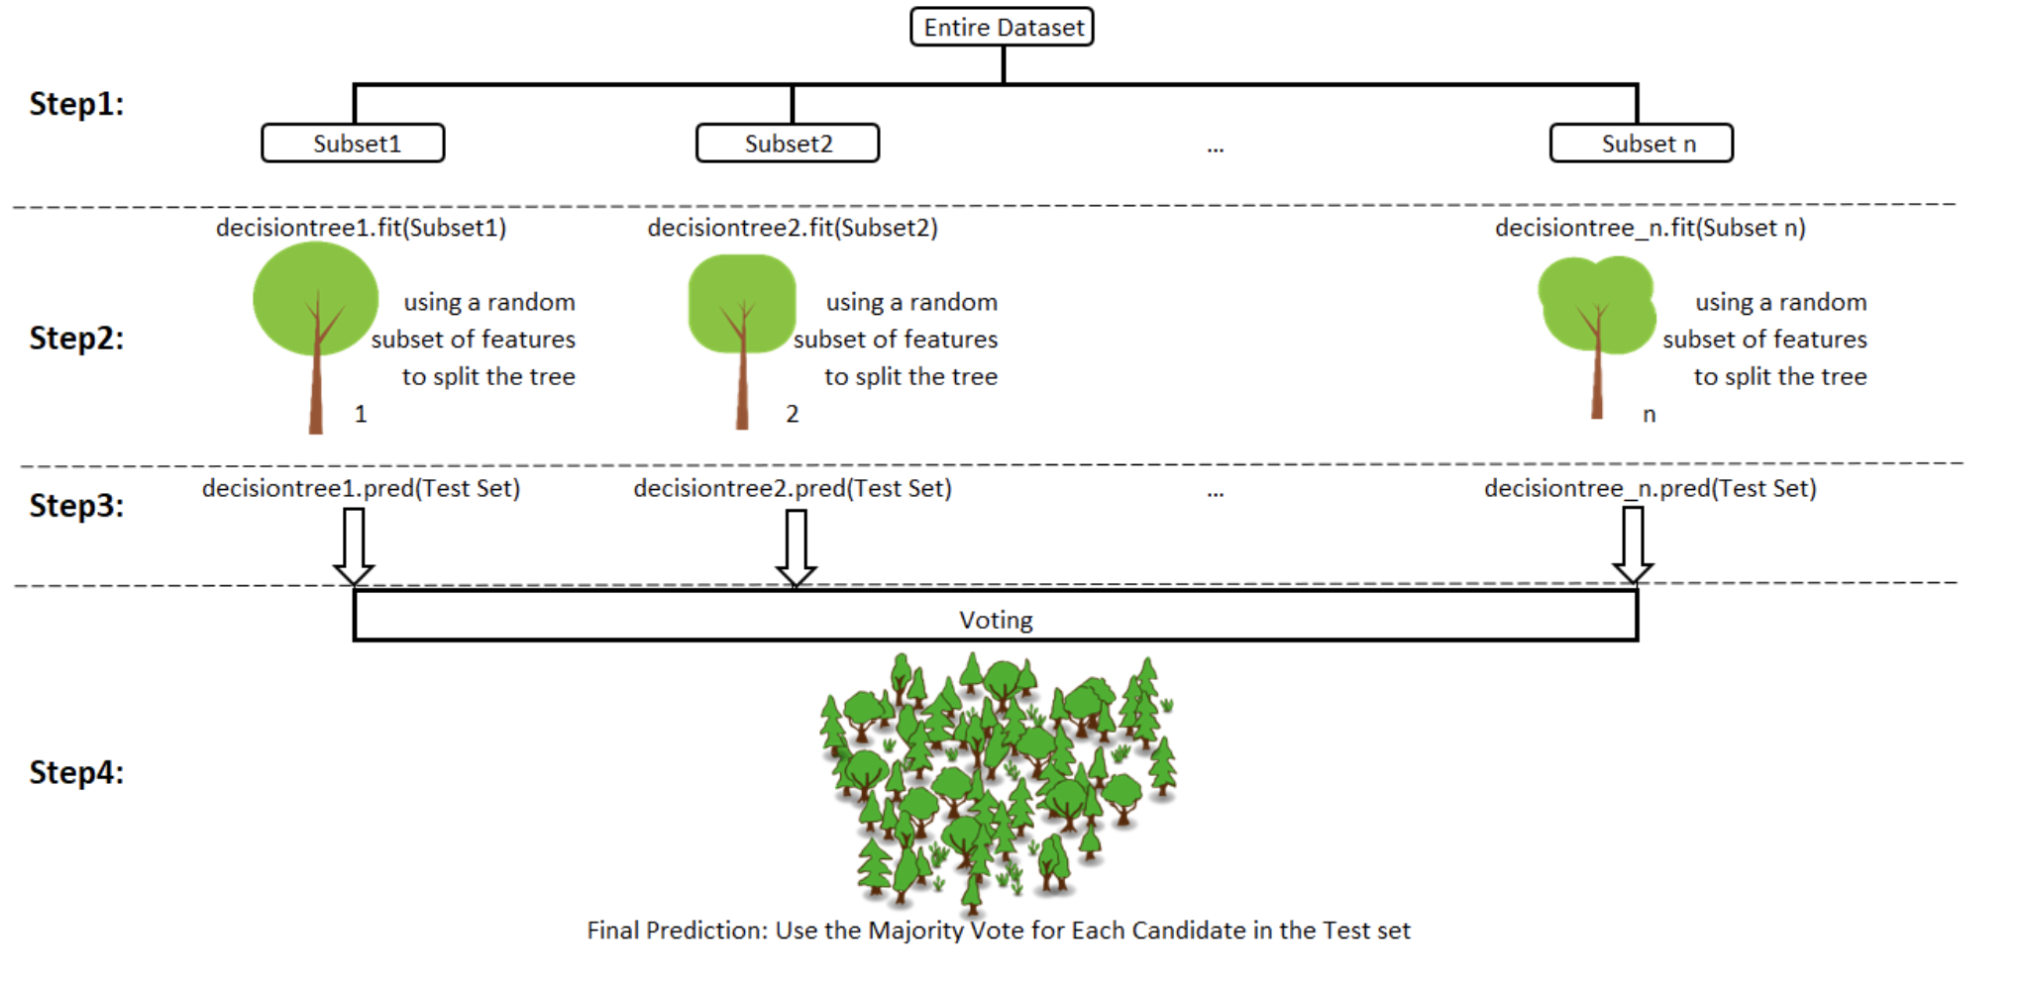
Visualizing the Forest

Slide 15
GET YOU’RE CODE ON!

